Slide 1
Spatial and Temporal Trends of Fine Particulate Matter in Western Oregon
Makoto Kelp

Slide 2
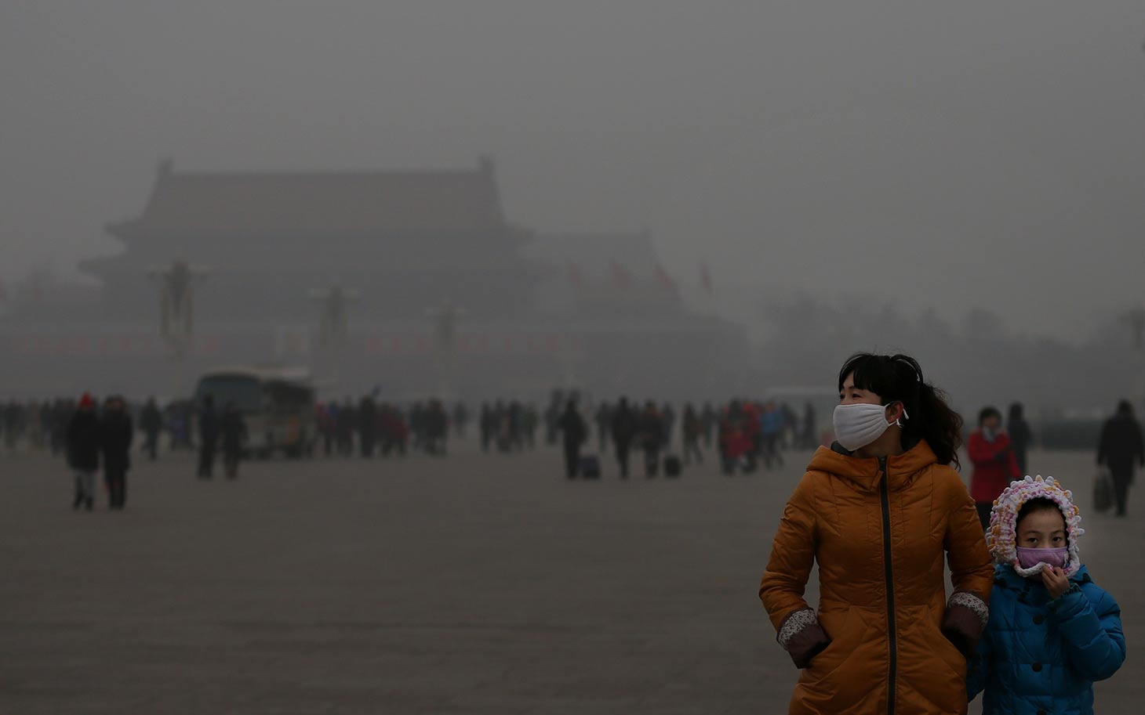
Notes:
A little bit sensationalist, but extreme cases like Beijing help to illustrate that air pollution matters

Slide 3
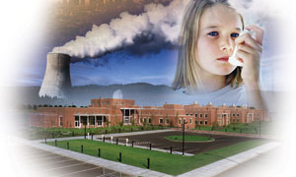
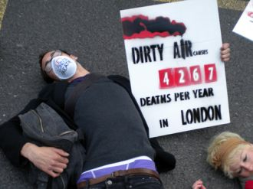
Notes:
My judgment:
I hate sensationalist stuff like this. Almost propagandist. Yes pollution is bad, but I think it is important to understand it rather than simply championing with ideas as “pollution = bad”
In fact there is much more natural pollution (biogenics) than human made.
Nevertheless, it is still an important issue.
Julie Fry always taught me to approach research with your head and not your feelings.

Slide 4
What is Particulate Matter (PM)?
Aerosol: total amount of suspended solid and liquid particles in the air.
PM:
Class of Aerosol
Natural and Anthropogenic Sources
Result of Incomplete Combustion:
H_{x}C_{x}+ O₂ → H₂0 + CO₂ + heat + charred PM
PM_{2.5} or Fine PM
2.5 refers to diameter of the particle in micrograms/m3
“Fine” because not discernable to the human eye
Sources: fine PM may form from inefficient combustion due to motor vehicles, residential wood burning, and other local industrial processes.
Notes:
Phases of Matter: s, l, g
Dust can be an aerosol

Slide 5
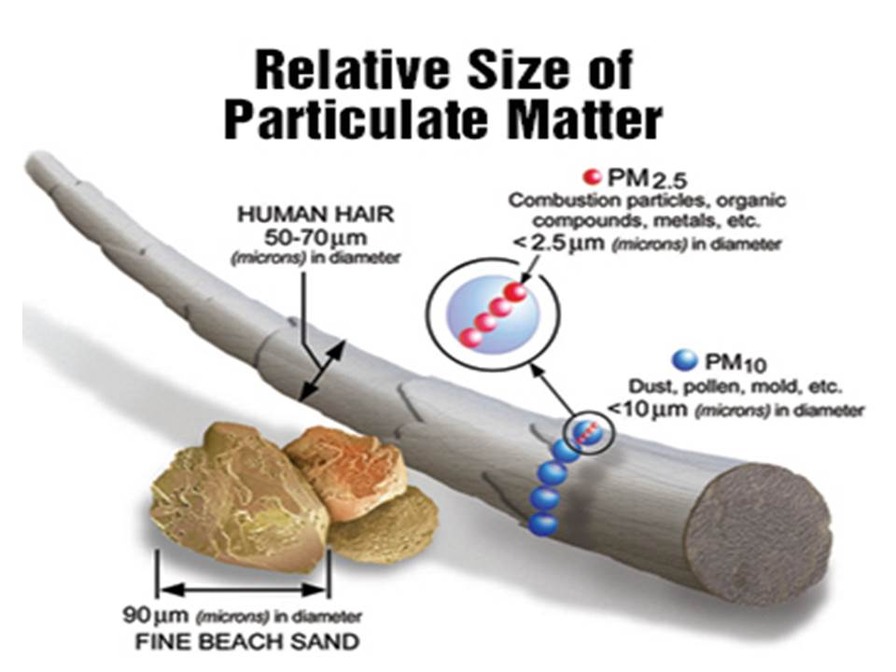
Relative Size

Slide 6

Health Effects of PM: Lung Deposition
Notes:
Health Effects: penetrate deep into the lung because it is not big enough to deposit at the entryway (unlike coarse PM)

Slide 7
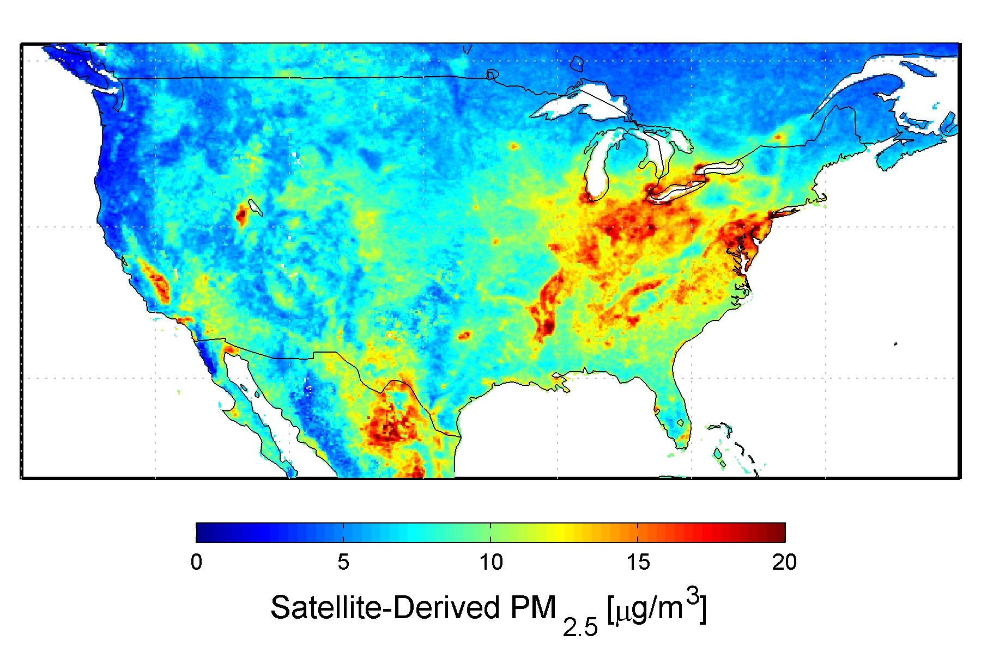
National Trends, Global Radiative Effects
Notes:
PM varies regionally
"Fine particles also have seasonal patterns. PM2.5 values in the eastern half of the U.S. are typically
higher in the third calendar quarter (July-September), when sulfates are more commonly formed from sulfur dioxide emissions from power plants in that part of the country. Fine particle concentrations tend to be higher in the fourth calendar quarter (October-December) in many areas of the West, in part because fine particle nitrates are more readily formed in cooler weather, and wood stove and fireplace use produces more carbon.” TREES

Slide 8
Data
Supplied by Anthony Barnack (upon request) from the Oregon Department of Environmental Quality (DEQ)
Period of two years from January 2013 to February 2015 (did not use Jan, Feb 2015 for analysis)
Two years, eight seasons
Data: PM_{2.5} concentration in micrograms/m3 at nine different monitoring sites from Western Oregon including SE Lafayette in Portland to Salem, Corvallis, etc.
Monitored hourly every day

Slide 9
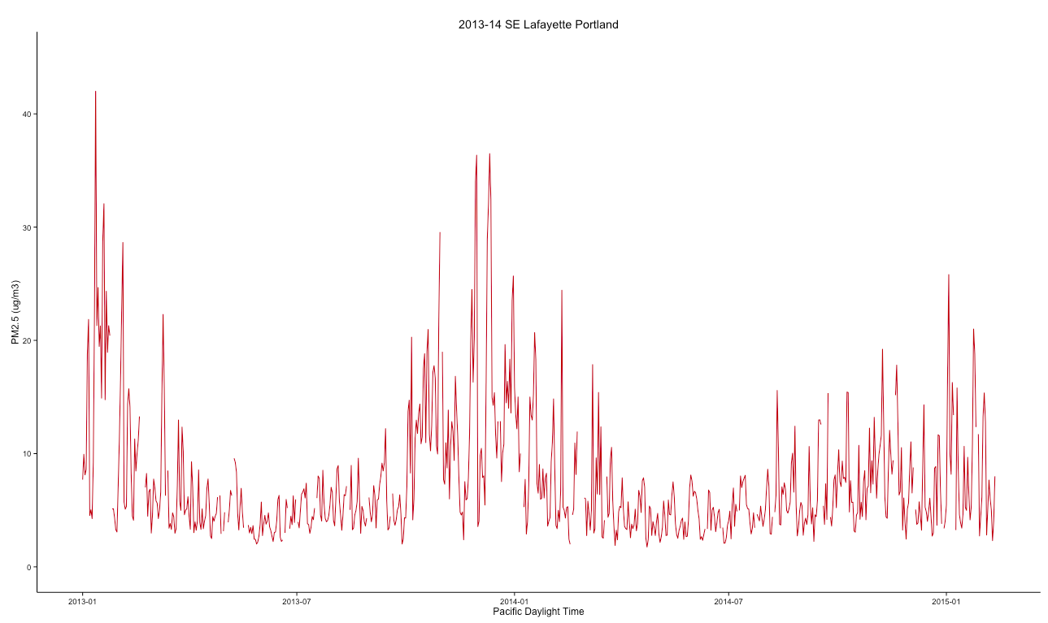
Exploratory Data Analysis
Notes:
This shape is due to the fact that there is more combustion activity in the winter (think home heating) than in the summer. If we assume that PM's sink is deposition and assume the same rate of deposition for all seasons, then it makes sense that the season with the highest rate of production (winter) will have higher overall concentrations.
2) Jagged lines: One must also note that PM is highly susceptible to specific source events that can drive the average up for a period of time (such as a fire or congregation of old diesel trucks). HOURLY VALUES

Slide 10
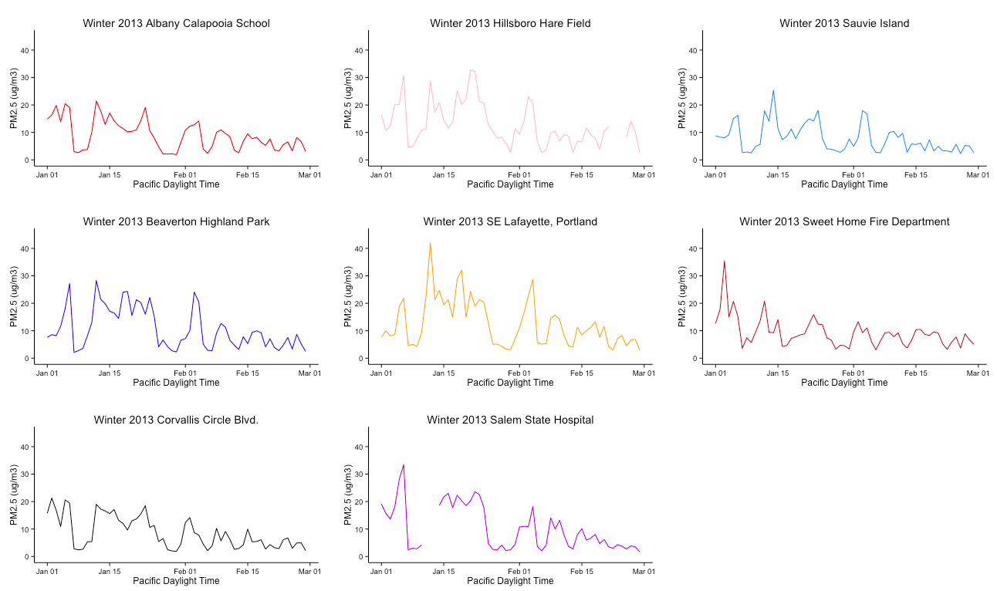
Winter 2013
Notes:
Note: Daily Averaged Values
1 Magnitude
2 Spikes line up?

Slide 11
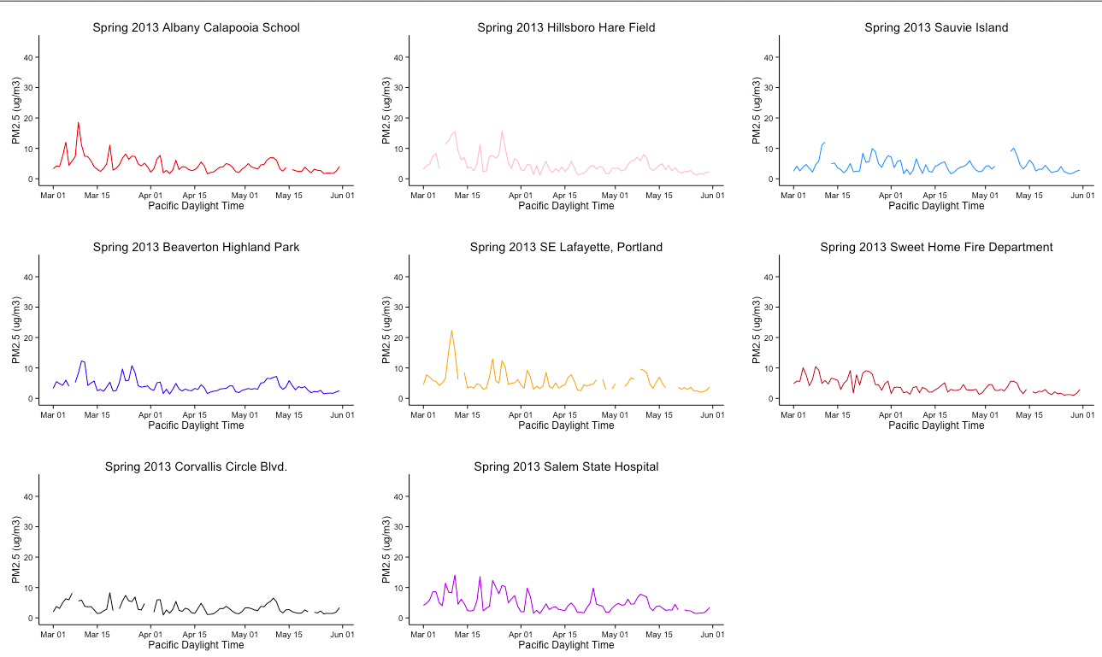
Spring 2013
Notes:
Smaller magnitude (Same scale), spikes also line up

Slide 12
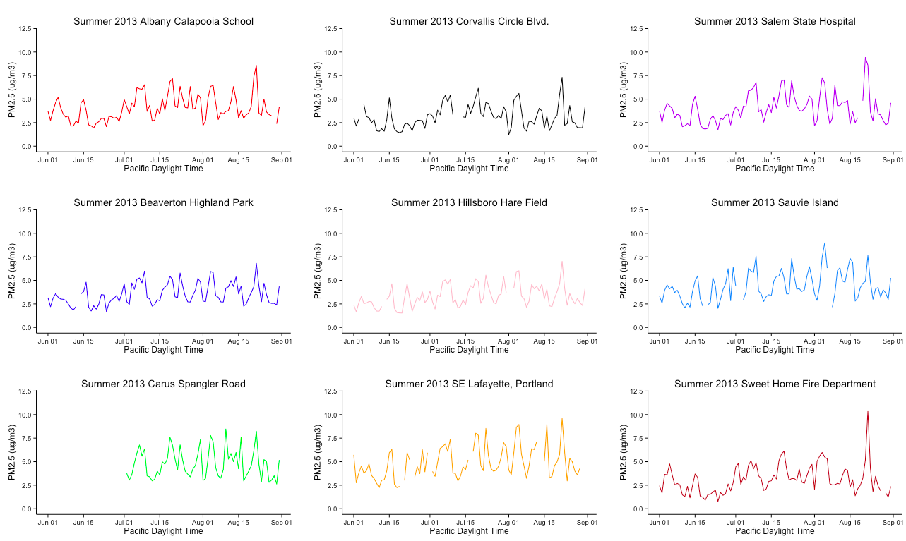
Summer 2013
Notes:
New scale, note magnitude much smaller, talk about individual events driving each day (even more variation during a day) (Diurnal drops at 3 pm, high at rush hour)

Slide 13
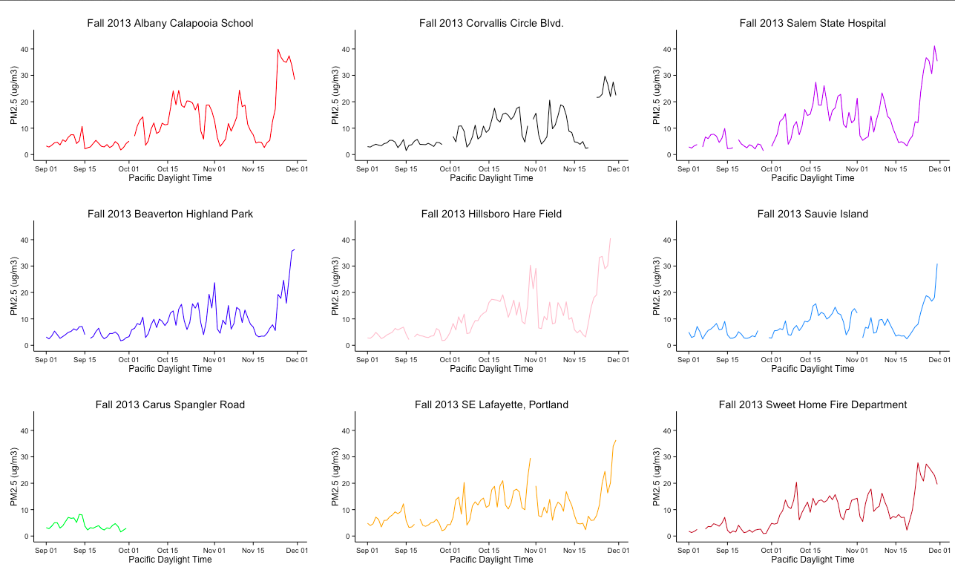
Fall 2013
Notes:
Magnitude increasing back up again approaching winter, note the last increasing peak in all data→ what is this? See next few slides and talk about are there in season patterns?

Slide 14
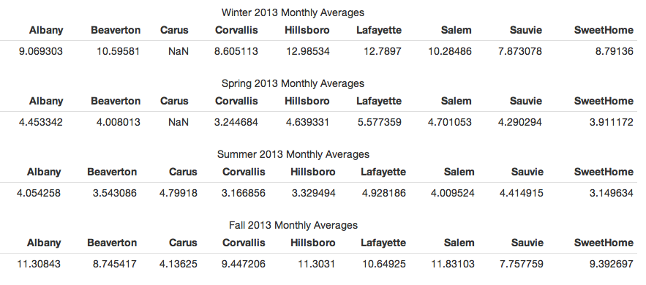
Seasonal Mean Concentrations
Use Portland as a Comparison!
“Ceiling” and Proximity
Notes:
We have done spatial comparisons, perhaps look into more temporal comparisons comparing multiple years worth of data for a site

Slide 15
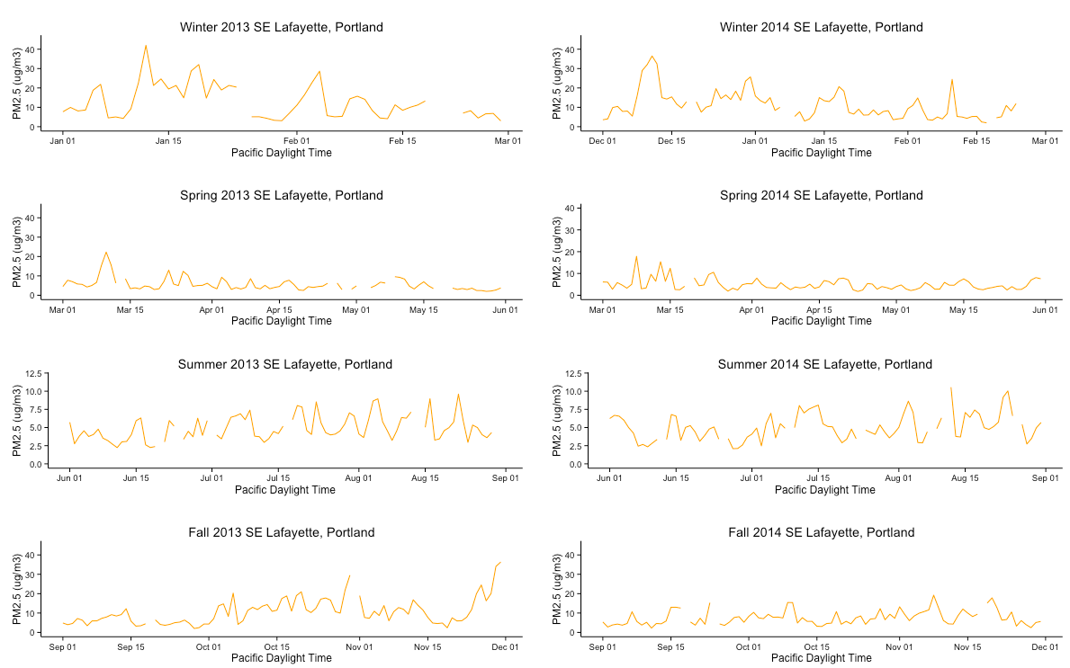
Temporal Variations: Lafayette
Notes:
In season Trends? Not really
Seems random with peaks, except maybe large peak in fall 2013, 14? Wanted to investigate phenomena, See next slide

Slide 16
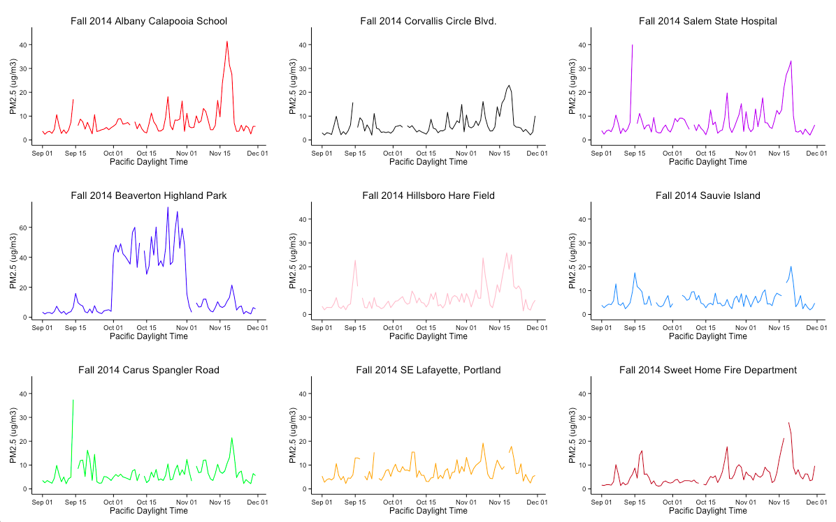
What Happened Here? A lesson in Exploratory Data Analysis
Peaks line up
Notes:
1) Wanted to see Large peak events near end? High influx of wood burning? Near Holidays? Higher rates of travel?
2) Beaverton data corrected → 60 ug is crazy! Beijing Levels

Slide 17
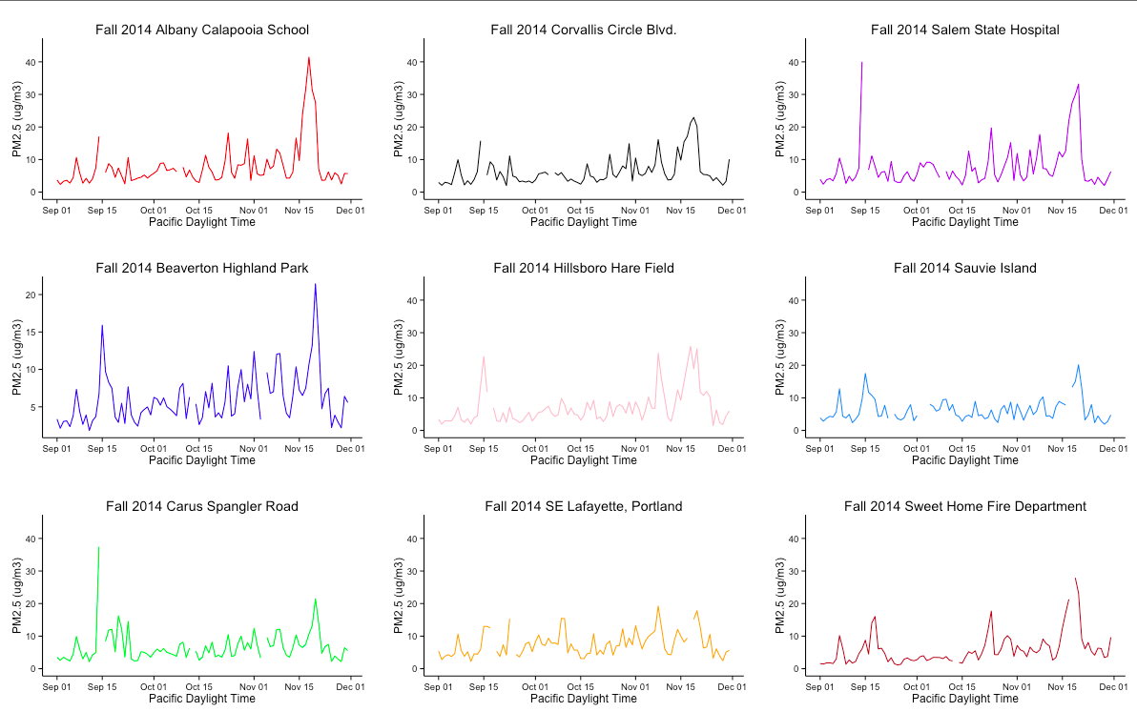
That’s Better
Notes:
Fixed by DEQ

Slide 18
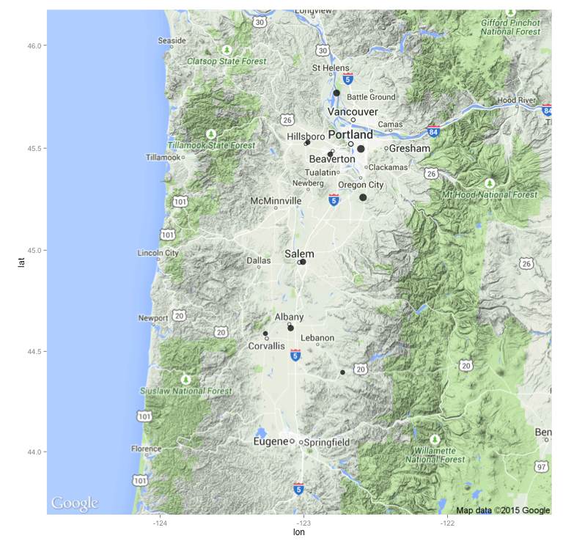
Map of Western Oregon Summer 2013
Notes:
9 sites

Slide 19
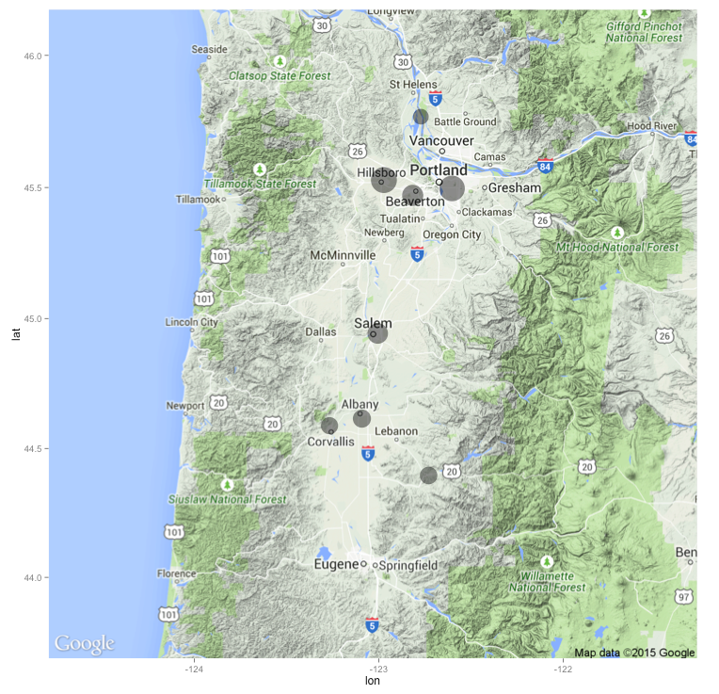
Map of Western Oregon Winter 2013
Notes:
Carus Missing near Oregon City

Slide 20
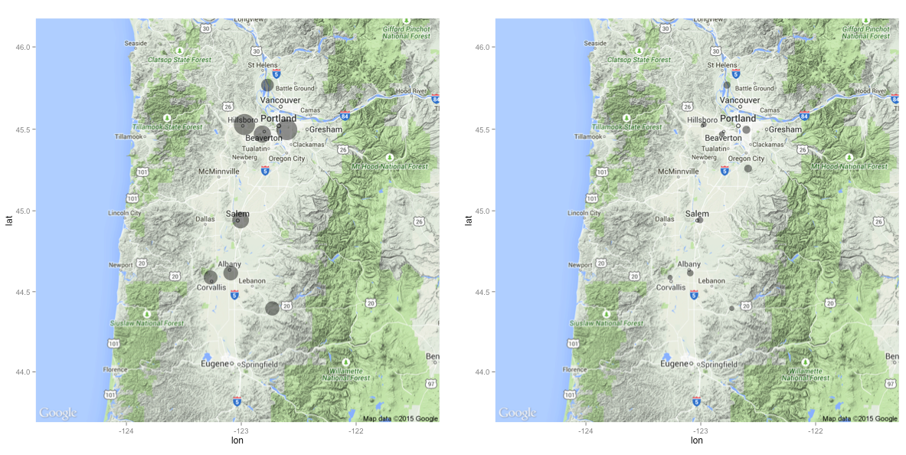
2013 Seasonal Comparison
Notes:
Urban Areas = more PM! duh

Slide 21
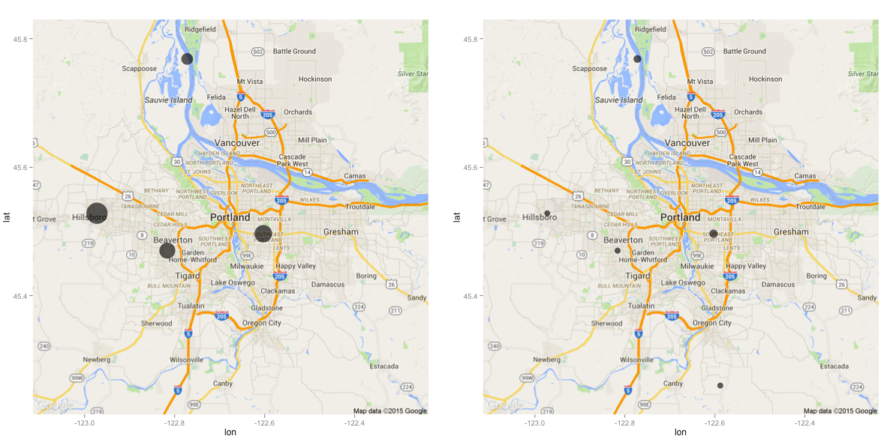
Portland 2014 Comparison
Notes:
Sauvie Island is very weird, lots of organics (fertilizers, Organic matter) in the air, how can we test?
Hillsboro pretty large?

Slide 22
Point Sources
Notes:
As mentioned before Notice not smooth line, but rather series of individual events, DAY TO DAY

Slide 23
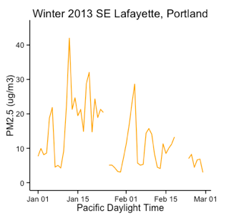
Closer Look: Averages Misleading
42.0000 micrograms/m3
Monthly Average: 12.7897 micrograms/m3
Notes:
Although we derive a monthly average value from these of 12.7897 ug/m3, these values are from peak events that are much higher than that value,
What does this mean in terms of health?

Slide 24
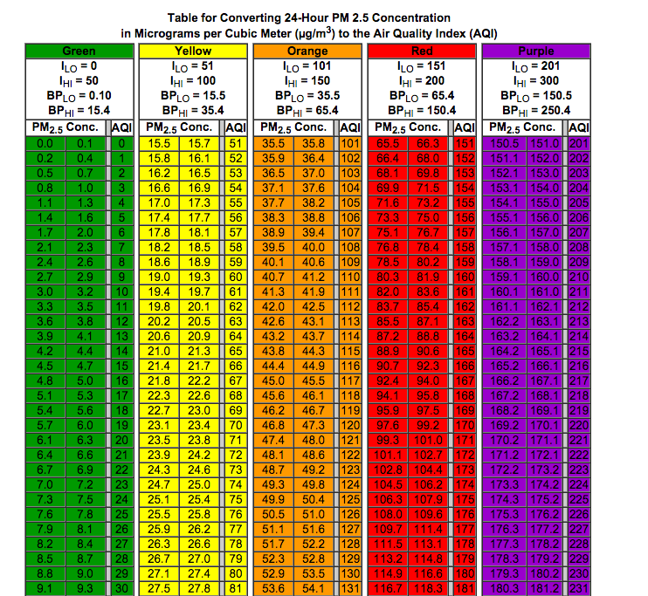
Average = Green
Peak = Orange

Slide 25
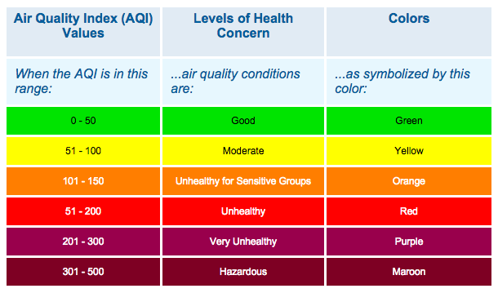
AQI

Slide 26
Conclusions
Variable Depending on Region
PNW Annual Pattern: Peak in Winter, Trough in Summer
Dependent on combustion activities (industry, vehicles, home heating) and Temperature
No statistically significant In-Season Pattern
Urban Areas (PDX) produce PM than rural areas
Significance of Peak Events and Point Sources

Slide 27
Extensions
ARIMA (Autoregressive Integrated Moving Average) calculation that may help determine the "staying power" of a pollutant, that is, its potential atmospheric lifetime.
Using larger data set do ID more seasonal patterns and potentially link them to specific events

Slide 28
Acknowledgements
Albert Kim and Math 241
Julie Fry, Ben Ayres, Reed Chemistry Department
Anthony Barnack and Kevin Downing from the Oregon DEQ

